Slide 1


Medictionary
Jeongyun Lee
Ronnel Mattew
Eyad Al Hafi
Marc Visa
Notes:
Main page :

Slide 2

Index
1st Sprint
01 >>
Project introduction
02 >>
General Architecture
03 >>
Requirements
Sprint planning
04 >>
05 >>
Use Cases & User stories
05 >>
Database Model
06 >>
Financial Architecture
07 >>
Mock up & Prototype App

Slide 3

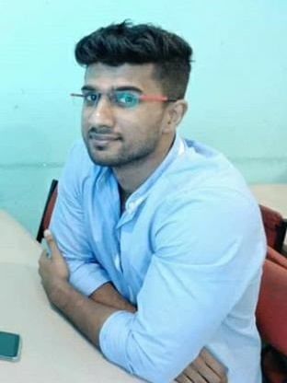


Team Members
Jeongyun Lee
Ronnel Mattew
Marc Visa
Eyad Al Hafi
Developer
Financial Expert
Scrum Master
Developer
00 Team Members

Slide 4
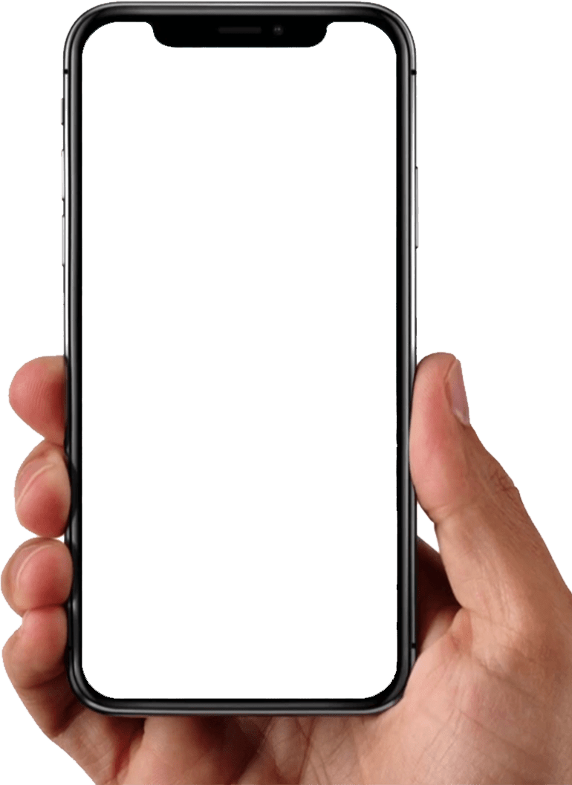
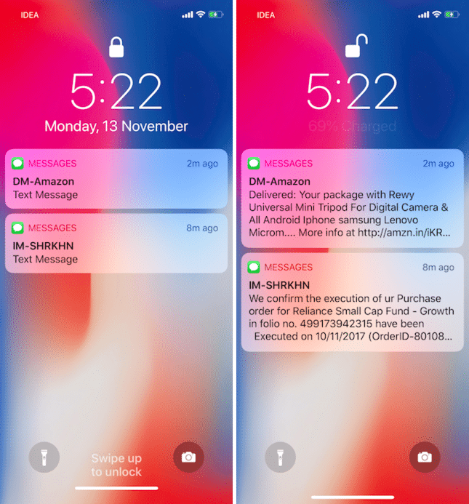





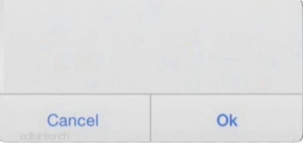
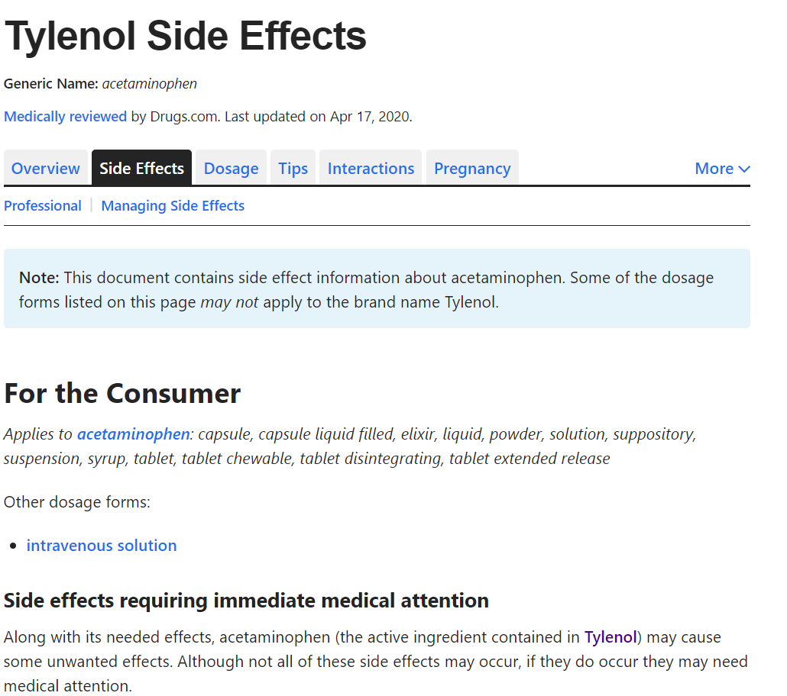


01.Project Introduction
Searching The Pills
Searching the pills with the shape, the color and the code
white, oval, paracetamol
Providing the information of the pill including the ingredients, dosage , effects and etc.
You missed the medicine
CAUTION!
Your medicine A and B is conflicted
They can cause the side effect
Jake needs to take his medicine in 30 min
Setting Alarms
Reminding the time to take the medicine for user and user’s family
CAUTION!
Do Not Drink - Tyrenol
Alcohol can damage your liver.
Cautions
Notification the guide line in the daily life
Notes:
Warning the ingredients in conflict

Slide 5






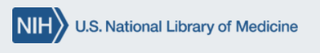

02.General Architecture
Server / DB
Client
External Resource
Alarm
Notification

Slide 6






03. Requirements
Function 0
Sign up & Sign in
Function 2
Alarm & Pillbox
Scrum &
Project Managing
Sign up , Sign in with username / pw
Sign up, sign in with Google Account
Sign up, Sign in with Facebook Account
Setting Alarm
Pillbox
Sprint meeting minutes
Presentation resource
Sprint explanation
General Architecture
Financial Architecture
Mock Up
Function 1
Searching Pill
Function 3
Notification
Backend
Start menu
Searching bar with name / characteristic
List up page
Pill description page
Pop-up Notification
Notification scenario
Alternative DB resource
DB data model
Research for external API
Connect to API to retrieve data

Slide 7
04. Sprint Planning
Connection to the API
Push notifications
Retrieve real data from the API
Development
Setting Alarms
+ Sprint daily meetings
+ Product backlog & Sprint backlog
+ Sprint Explanation
- UI Screen-shots diagram
Scrum
Planning
Data model diagram & explanation
Documentation
Financial factors
- General System Structure
- User story, User cases

Slide 8
04. Sprint Planning
Product Backlog Item
<function 2 - alarm notifications>
Alarm notifications. (time to take the medicine, dosage, etc.)
backend : retrieve real data from API
Pillbox screen
Setting alarms
<function 3 - caution notifications>
Caution notifications. (conflicted medicines, )
Another API to manage the caution notis
Upgrade UI design by improving app usability
Sprint Backlog Item
2nd sprint
Connect to the API to retrieve real data of medicine information in order to show it to the screen in the app.
Pushing notifications when alarms are set
Setting alarms and customize them (sleep time)
Update the use case diagram and explanation
Update the general architecture system
Update the product backlog and sprint backlog
update the financial part excel file
update the financial part documentation
pillbox functionality
Notes:
Marc,
you don’t’ need to explain everything. Just show them we did Userstories, and Uscases both.
Basically the contents of Users stories are same with Use cases.
So you can just read 1 or 2 cases of user story and acceptance criteria, and you can just say,
We don’t have much time, so if you want to se more details of Userstory, you can access with this link ( right side) or github easily.

Slide 9
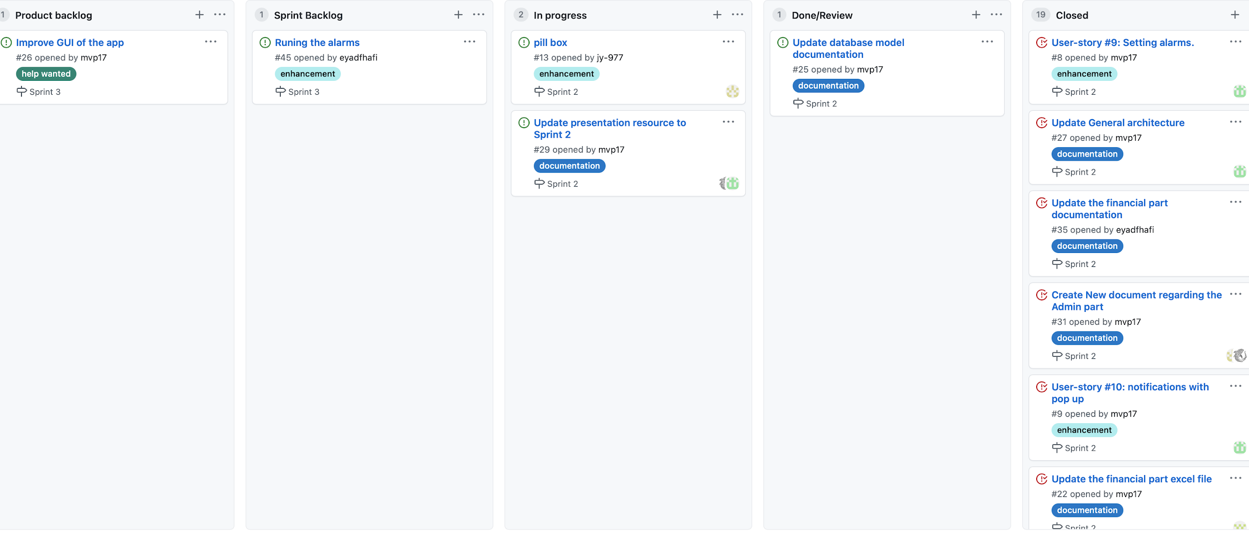
04. Sprint Planning

Slide 10
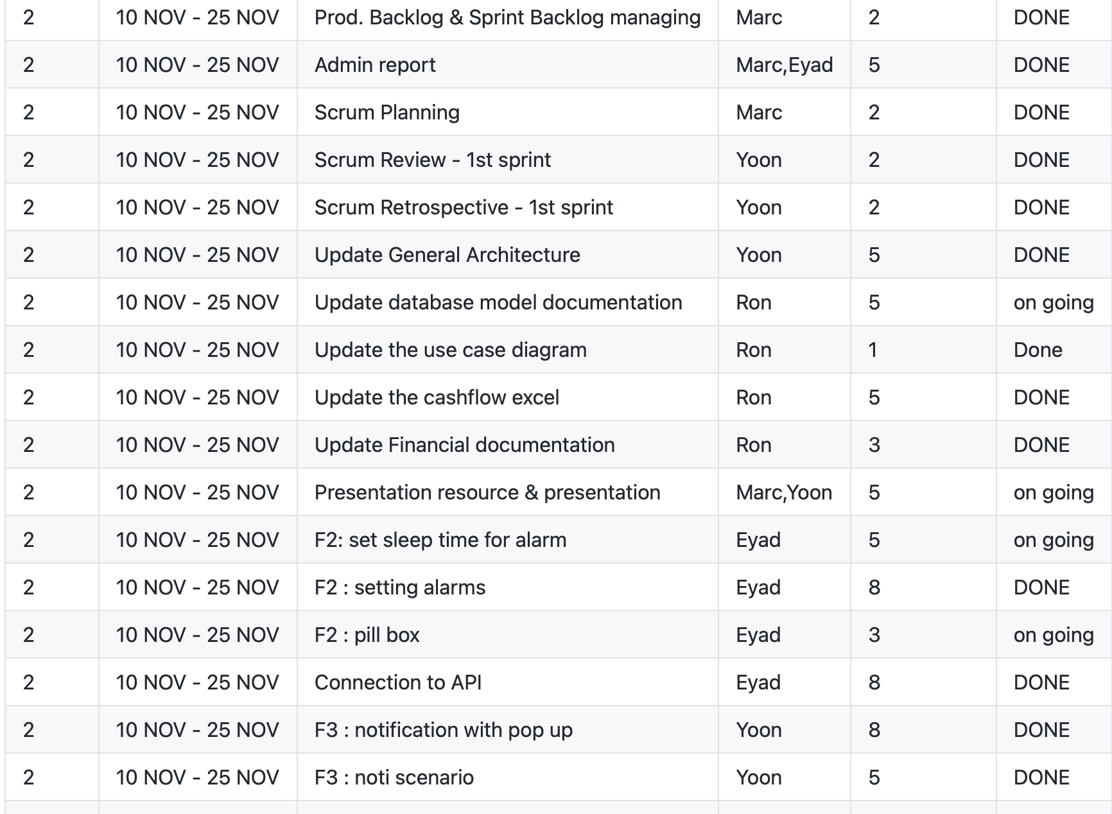
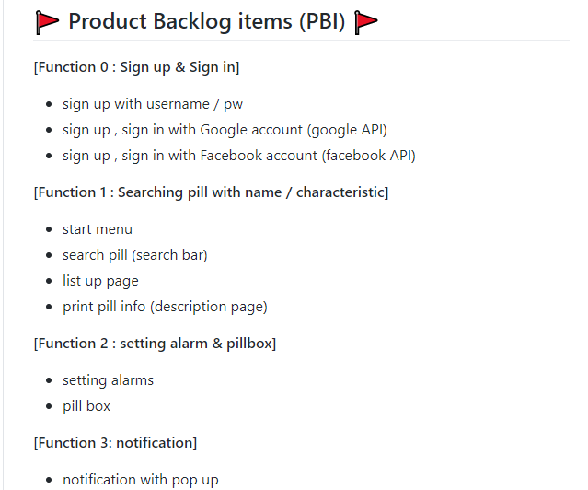
04. Sprint Planning
Product Backlog Items
Sprint backlog tasks
https://github.com/jy-977/ICT-medictionary
https://github.com/jy-977/ICT-medictionary

Slide 11
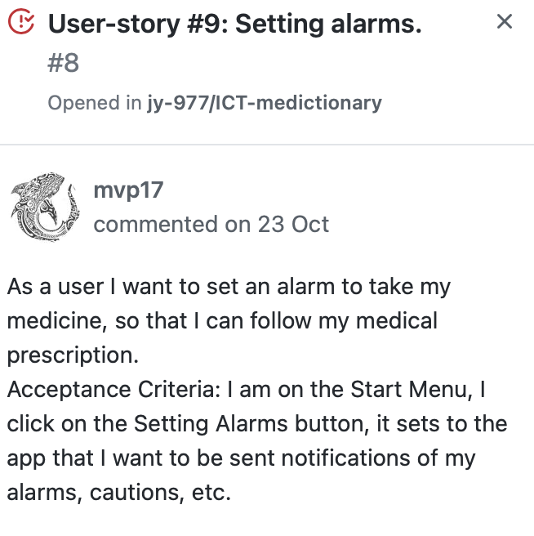
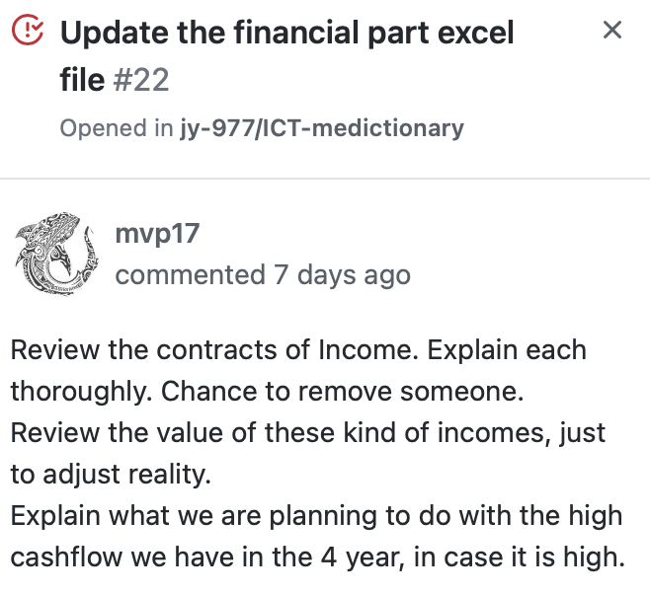
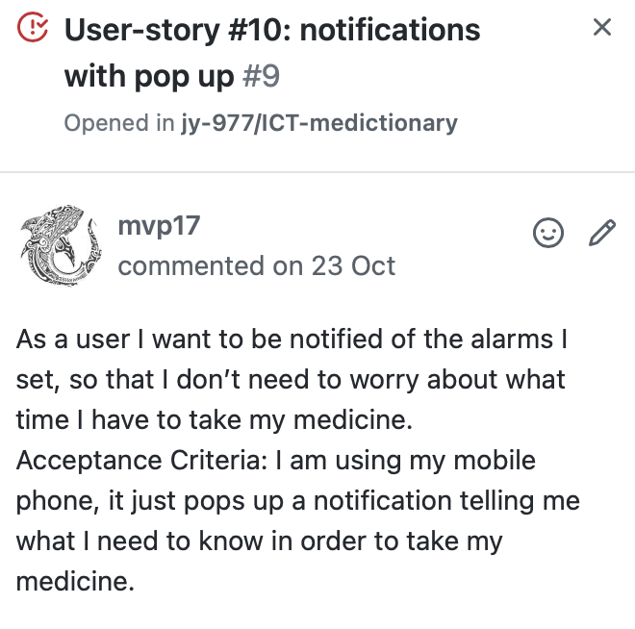
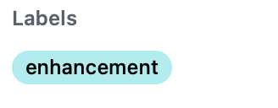
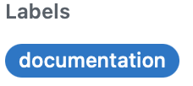
05. Sprint tasks & User stories

Slide 12
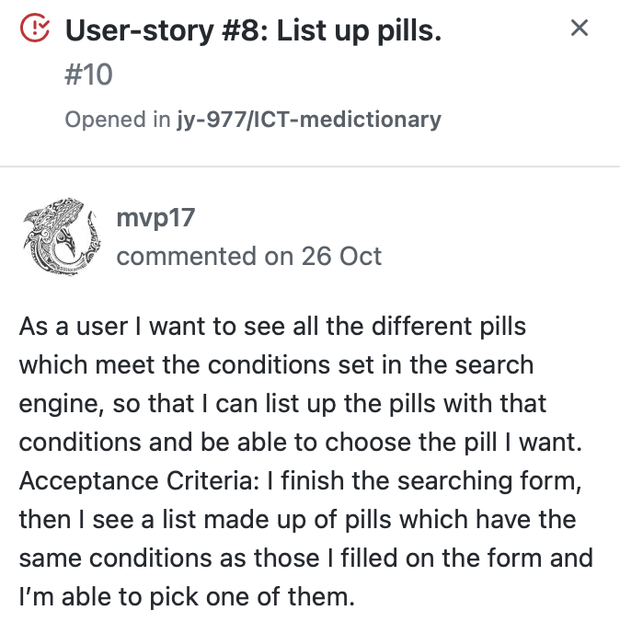
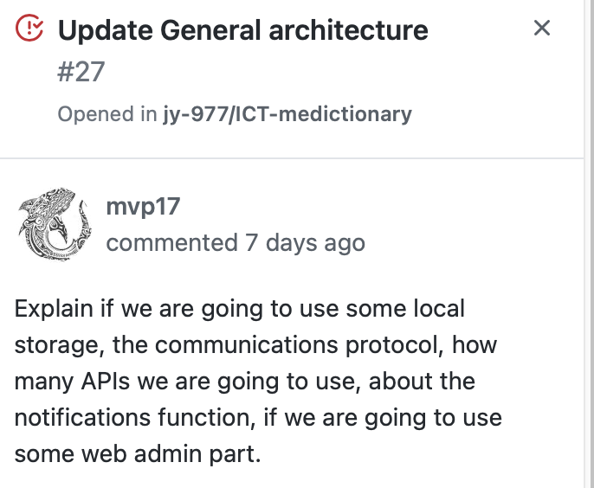
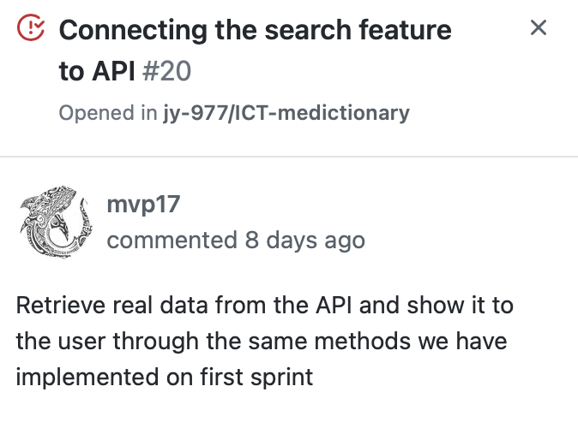
05. Sprint tasks & User stories

Slide 13
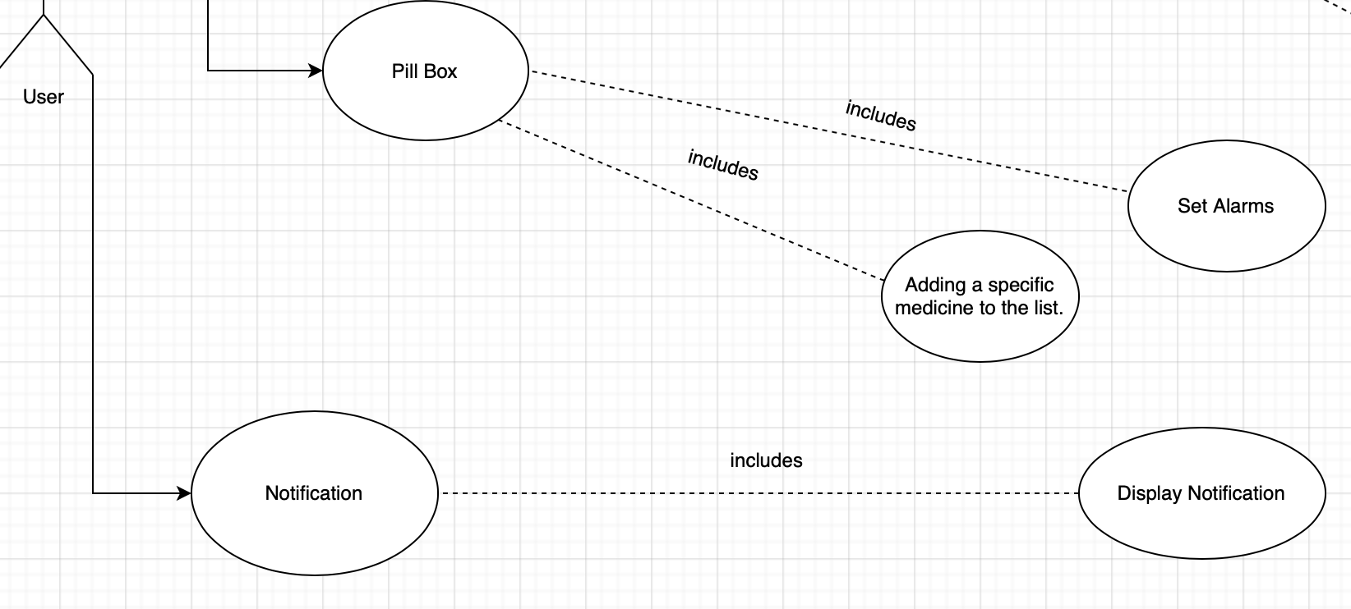
05. Use cases
Use Case Scenario
The user can access to all the medicines they are taking. Moreover, They can Set alarms based on the pills of pill box
Pill box
The user can access to all the medicines they are taking. Moreover, They can Set alarms based on the pills of pill box
Pill box
Notification
The user can be warned when they have the medicines
with conflicted ingredients and would get cautions for diet.

Slide 14
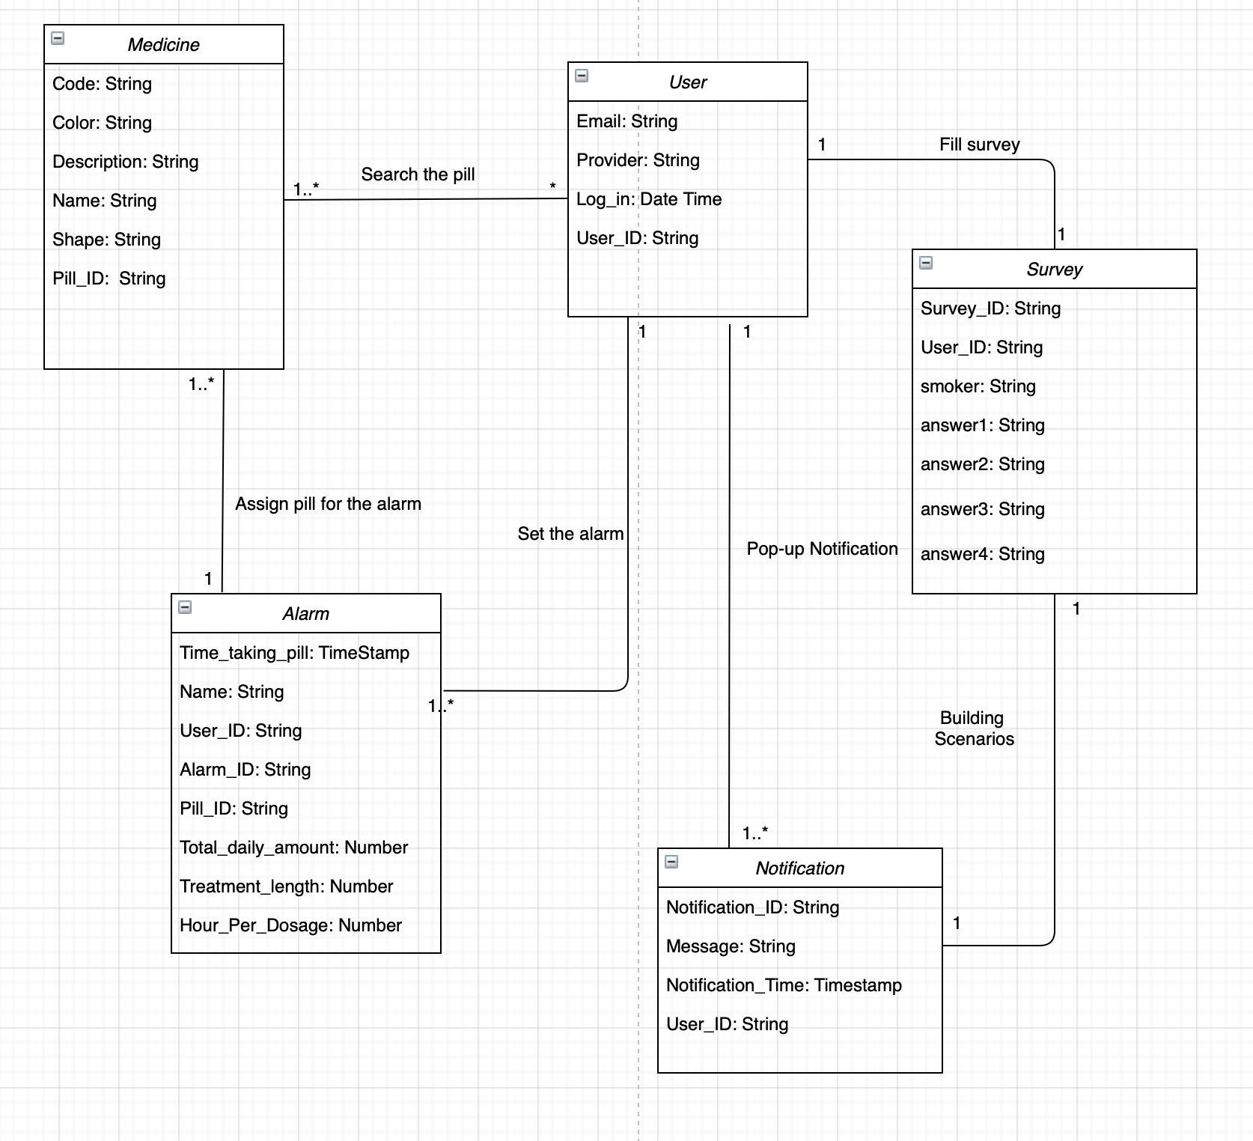
06. Database Model
Entities
For searching function : the code, shape, color and name
For delivering the information: description and side effects
For the data management : Pill_ID (primary key)
Medicine
User
For authentication : user, email, provider , login
For the data management : User ID (primary key)
For alarm function : Tme_taking, Name (alarm name)
For delivering the information: description and side effects
For the data management : Pill_ID (primary key)
Alarm
Notes:
DB model not modified yet!

Slide 15
06. Database Model
Entities
For searching function : the code, shape, color and name
For delivering the information: description and side effects
For the data management : Noti_ID (primary key)
Notification
Survey
For listing the pills : Pill_ID (foreign key), User_ID (forieng key), Item_ID(primary key)

Slide 16
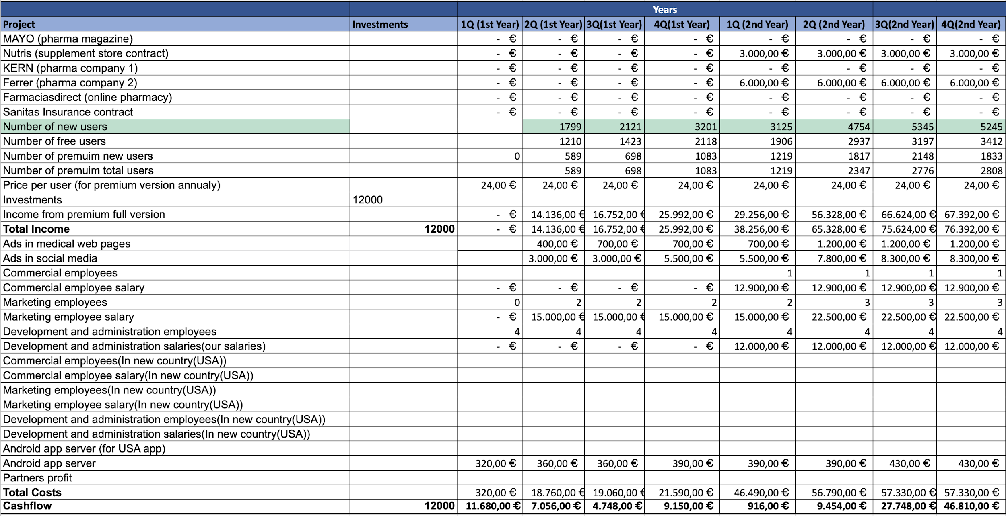
08. Financial Architecture - Cash Flow

Slide 17
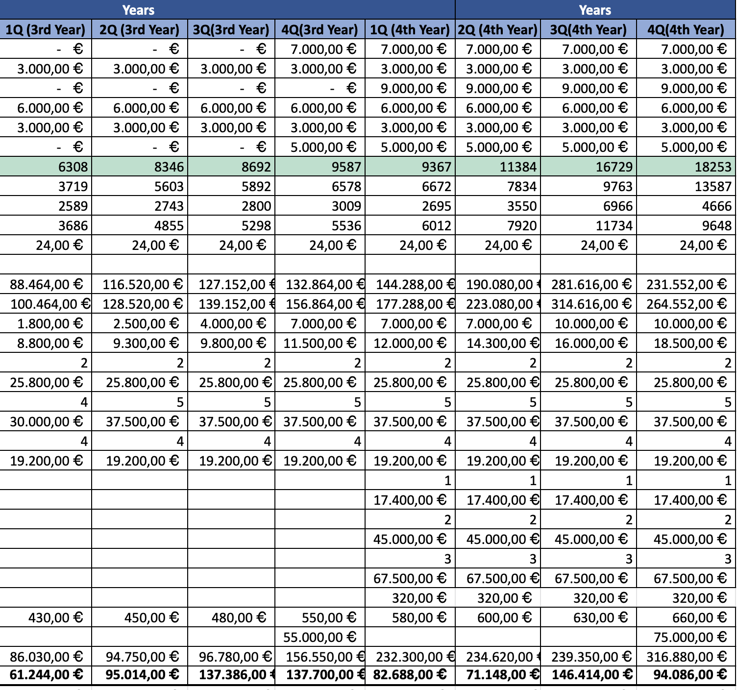
08. Financial Architecture - Cash Flow

Slide 18
08. Financial Architecture - Cash Flow
We have revised the contracts for the Income in the rows 5-10 in our cash flow table which includes different pharmacy companies and supplement stores.
In the contracts, we see that for the 1st year we have not signed any contracts because we would start hiring the commercial employees from the 2nd year who would start with the contracting process.

Slide 19
Contracts Description
We would sign contracts with the pharma and supplement companies (as mentioned from rows 5 - 10) to display their ads in our application which would be the source of Income, they are:
MAYO: Mayo is a company with Spanish capital with headquarters in Barcelona and delegation in Madrid that dedicates its main activity to the training of professionals in human and animal health, and the creation of strategic scientific communication solutions for the pharmaceutical sector. This company supports the pharmaceutical industry in the development of its marketing actions and creates continuous training, communication and publication projects together with scientific societies and patient associations.
Nutris: Nutris is a Spanish company, based in Madrid, specialized in the healthcare field, including food & food supplements, medical nutrition and sport nutrition. Focused in research, development and manufacturing of nutraceutical products.
KERN: Kern Pharma has a formulary that covers 90% of prescription needs. Its portfolio is made up of more than 230 products in more than 660 different presentations that seek to provide solutions to patients and healthcare professionals.
Ferrer: Ferrer is a vertically integrated organization. They offer truly innovative therapeutic solutions in 3 areas, namely: Hospital products, Prescription products and self-care products. In addition, they collaborate in the creation and support of foundations, continuous training of health professionals and are close to patients to detect unmet needs and provide solutions.
Farmaciasdirect: Farmaciasdirect was started in 2015, the year in which it was validated for the sale of EFP (advertising pharmaceutical specialties), appearing in the register of pharmacies authorized for online sales, which is operated by the Spanish Agency for Medicines and Health Products. Currently, farmaciasdirect.com has established itself as one of the main channels for purchasing pharmacy and parapharmacy products, not only for offering the best prices on the market, but also for offering a quality service and proximity.
Sanitas: With more than 20 years since its creation, the Sanitas Foundation is conceived as an element of health promotion and social transformation through research, the social integration of people with disabilities and the recognition of medical teaching. Supporting inclusive sport, research and health dissemination in Spain, the development of digital tools and the excellence of the best medical professionals, the Sanitas Foundation develops its objectives of social change, equal access to health and well-being of people.

Slide 20
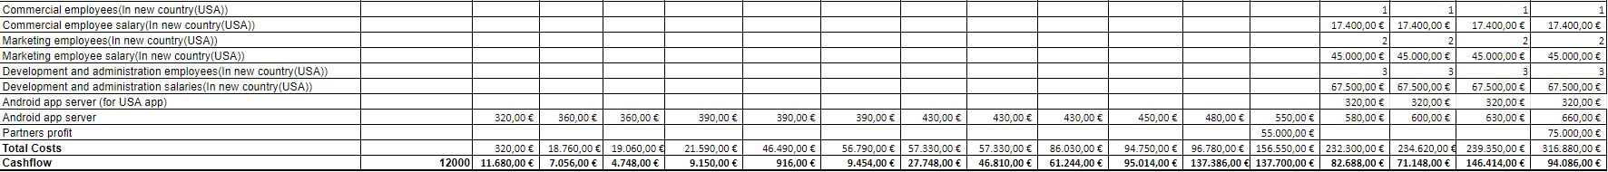
08. Financial Architecture - Benefits
There are some extra rows that have been added in order to prepare to start our business in another country. We have chosen the U.S and would hire some employees to start our business, but the costs associated with it would be considered in the last year.
In the last sprint, we were getting some negative values for the cash flow but we overcame that by increasing the costs by planning to start a new business in another country.
There is also a Partners profit cell added. We tried to calculate the values by taking 20% from the main value.
We have added an additional column for the initial investment of 12000€ for our company which would be as a startup in order to give a push to the company’s financial growth.
Investments

Slide 21
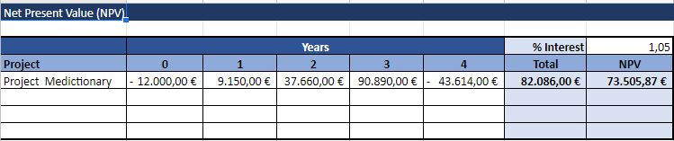
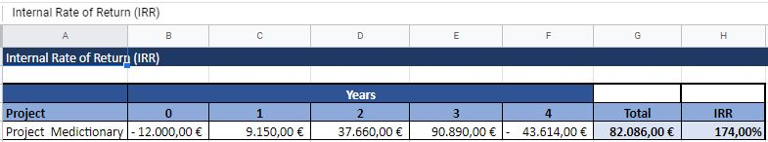
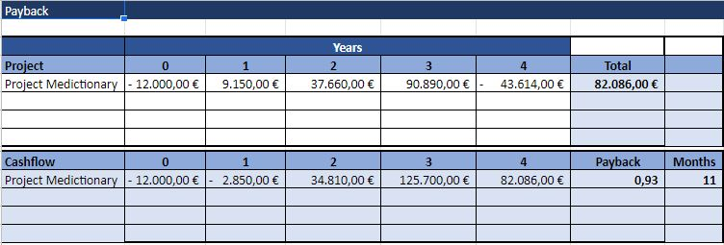
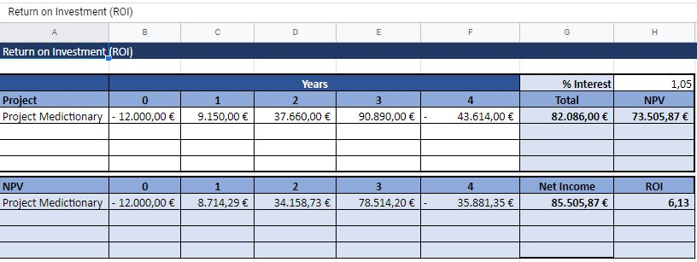
NPV, IRR, Payback, ROI and What-if
There is an added initial investment in the 0th year of each of the sheet and no major updates on the NPV, IRR, Payback, ROI and What-if sheets.

Slide 22
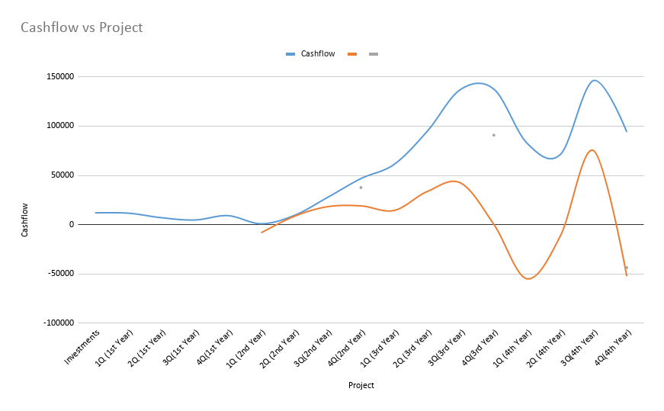
08. Financial Architecture Cash Flow

Slide 23
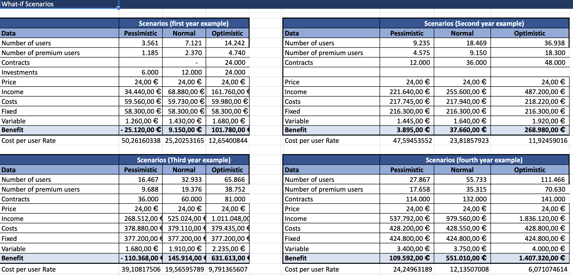
08. Financial Architecture What –if Scenarios

Slide 24
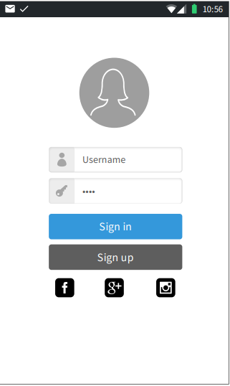
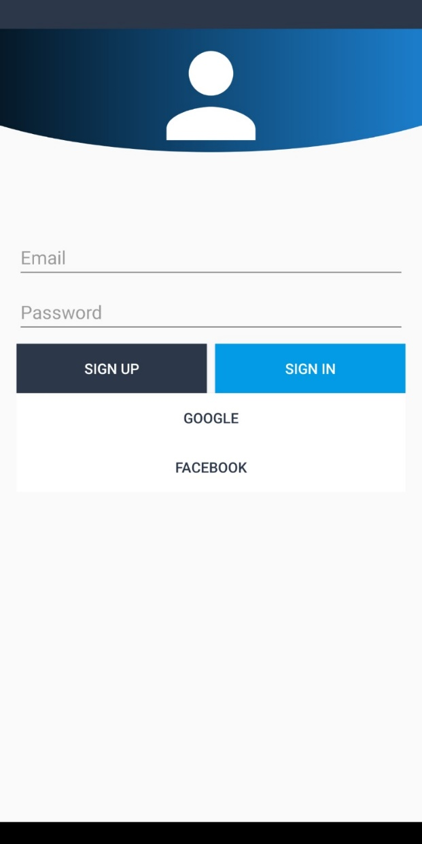
07. Mockup & Prototype App
Function 0 : Sign up, Sign in
Basically, User can join the application with Username (email) and password
Also, User can use the google or facebook account for sign up , sign in

Slide 25
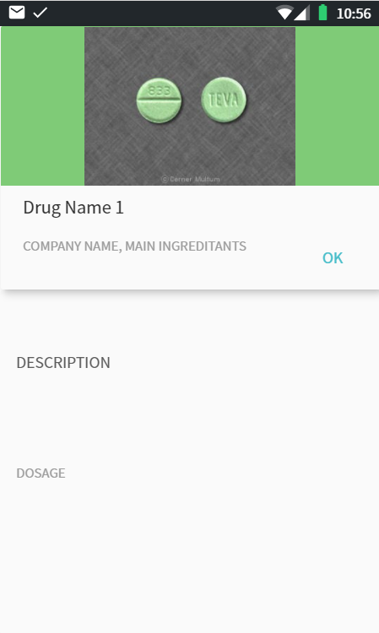
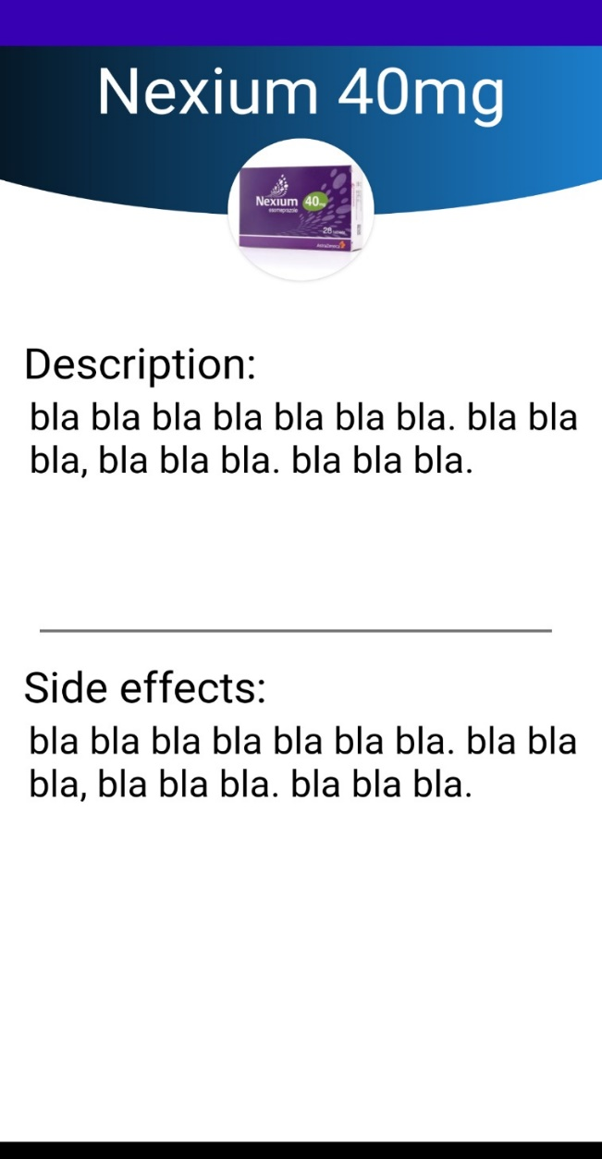
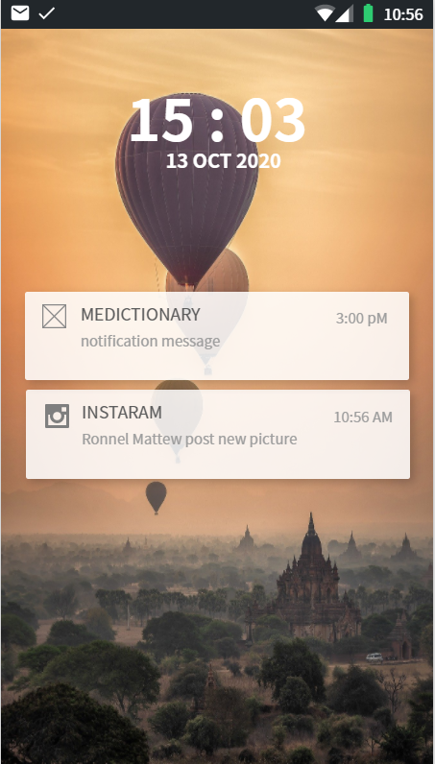
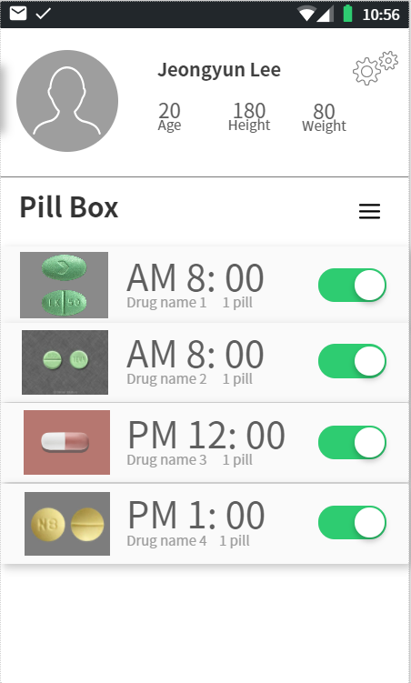
07. Mockup & Prototype App
Function 1 : Searching
The user can see the detailed information like the name of pills, description and side effects of pills.

Slide 26
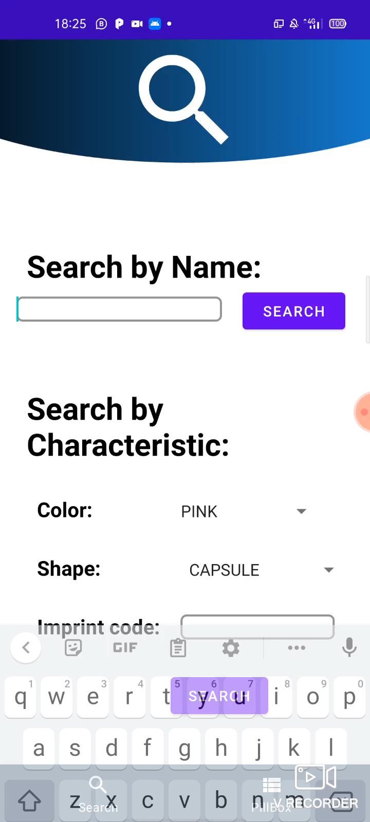
07. Mockup & Prototype App
Function 2 : Setting Alarm
The users can check the pills they are taking. Moreover, they can set alarm in this pill box page.
The pill box can be modified with the button next to the pill box. They can remove the pill which they don’t want to take anymore.

Slide 27
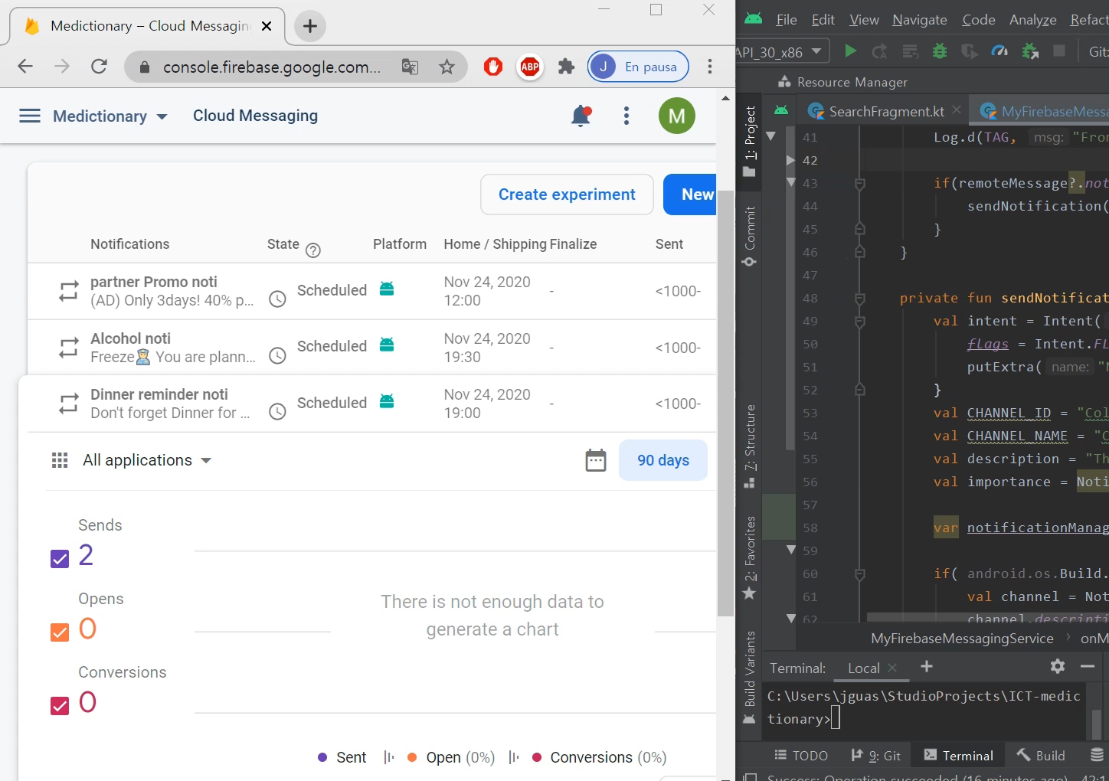
07. Mockup & Prototype App

Slide 28
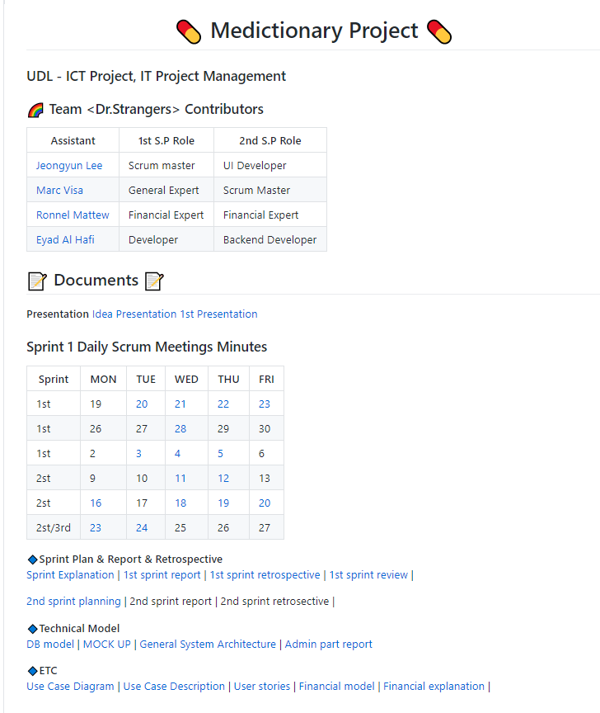
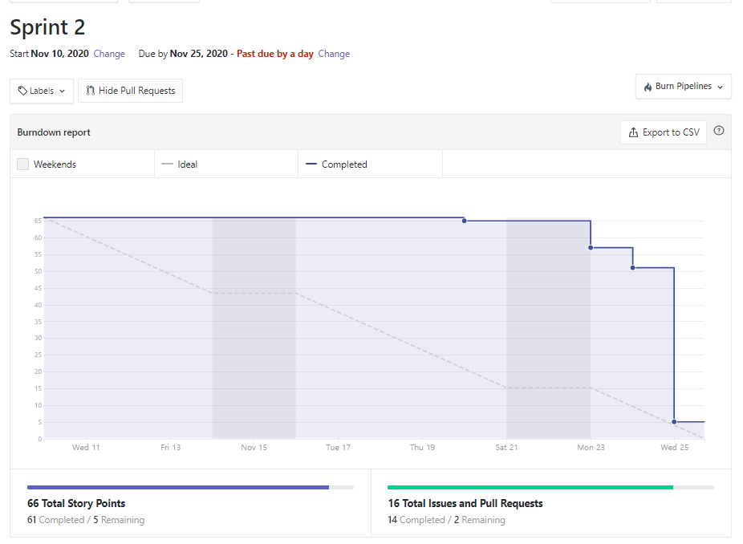
Moreover
If you want to see more details..

Slide 29

Issues
Admin Pages
API connecting
Android Problem
Privite Works

Slide 30
Q & A
Github
https://github.com/jy-977/ICT-medictionary
Jeongyun Lee
https://github.com/jy-977
Marc Visa
https://github.com/mvp17
Ronnel Mattew
https://github.com/ron7858
Eyad Al Hafi
https://github.com/eyadfhafi

Slide 31
Thank you for watching
Github
https://github.com/jy-977/ICT-medictionary
Jeongyun Lee
https://github.com/jy-977
Marc Visa
https://github.com/mvp17
Ronnel Mattew
https://github.com/ron7858
Eyad Al Hafi
https://github.com/eyadfhafi

